Slide 1

MARKETING STRATEGY PLAN
Launching a Promotional Video about Entertainment and Multimedia Computing ACROSS digital platforms.

Slide 2
Contents
Introduction
The Benefits of Promotional Videos
Strategy
Measuring Result
Platforms
Objectives
Target Audience
Content Plan
Budget
Timeline
Conclusion

Slide 3

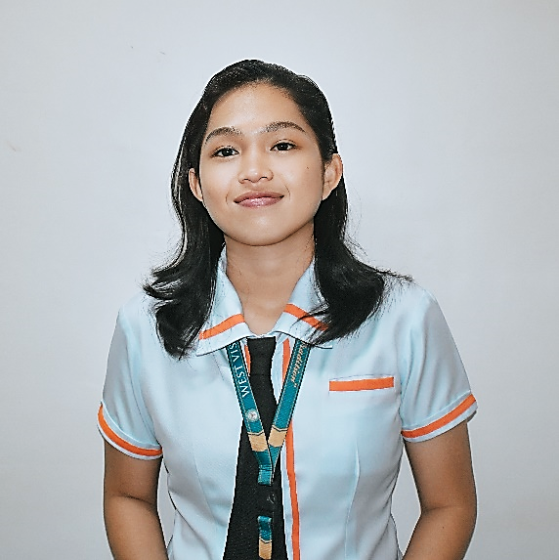
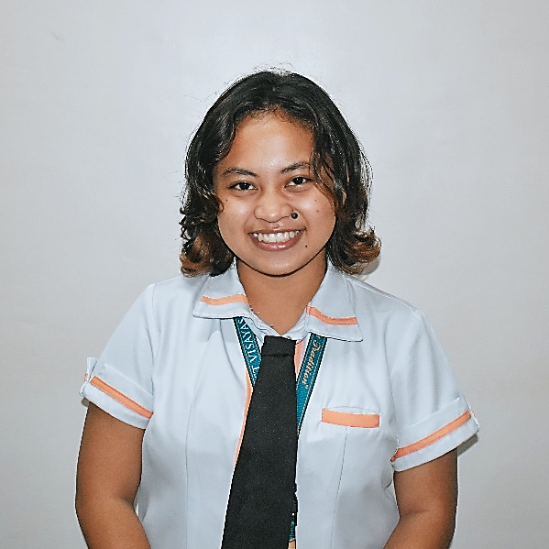
Marketing Team
ALLAN JUSTIN BOLIVAR
KYSTAL ANN SAYCO
APRIL PRINCESS SUELO

Slide 4
Introduction
The BS in Entertainment and Multimedia Computing program is designed to equip students with the skills and knowledge to create compelling digital media experiences.
This presentation will discuss the importance of creating a promotional video and how to effectively launch it in various digital platforms.

Slide 5
The Benefits of Promotional Videos
Promotional videos are a great way to advertise and reach a larger audience. They can be used to inform people about a product, service, or event. Additionally, they can be used to create brand awareness and increase sales.
Creating promotional videos can also help to build trust and loyalty with customers, as they can get a better understanding of the product or service being offered.

Slide 6
Strategy
The marketing strategy plan for promoting the BS in Entertainment and Multimedia Computing will involve uploading a promotional video to various social media platforms. This video will showcase the program's innovative curriculum and the potential for students to gain industry-relevant skills. Additionally, the video will be engaging and visually appealing to draw in potential students. We will also use SEO techniques to ensure that the page is easily found by potential students.

Slide 7
Measuring Results
Once the promotional video is launched, we will be tracking the number of views, likes, comments, and shares to measure the results.
It is also important to monitor the analytics of the video to determine how the audience is responding. This can help to identify what is working and what needs to be improved in order to increase the effectiveness of the video.

Slide 8
Platforms
Facebook
YouTube
Website
Target Audience
Incoming College Students mainly the NETIZENS.

Slide 9
Objectives
Generally, our goal is to upload a promotional video that will capture the attention of our target audience and provide them with the information they need to make an informed decision about enrolling in the program.
Specific Goals
To reach 500 views within a month (Promotional Video in FB)
To create course related content (FB Page)
To compile and showcase the students portfolio (Website)
To give an overview about the course
To meet the output deadlines

Slide 10
Benefits of FB Page
Provides platform to connect with our audience and share information about the program.
Powerful tool with over 2 billion active users, which can help us reach wide and diverse audience
Offers targeting and analytics tool, to track the success of our marketing efforts and make data-driven decisions to improve our outreach.

Slide 11
FB Page Content Plan
Course Overview
Student Testimonials
Industry News
Faculty Spotlight
Student Work Showcase
Q&A
Alumni Success Stories

Slide 12
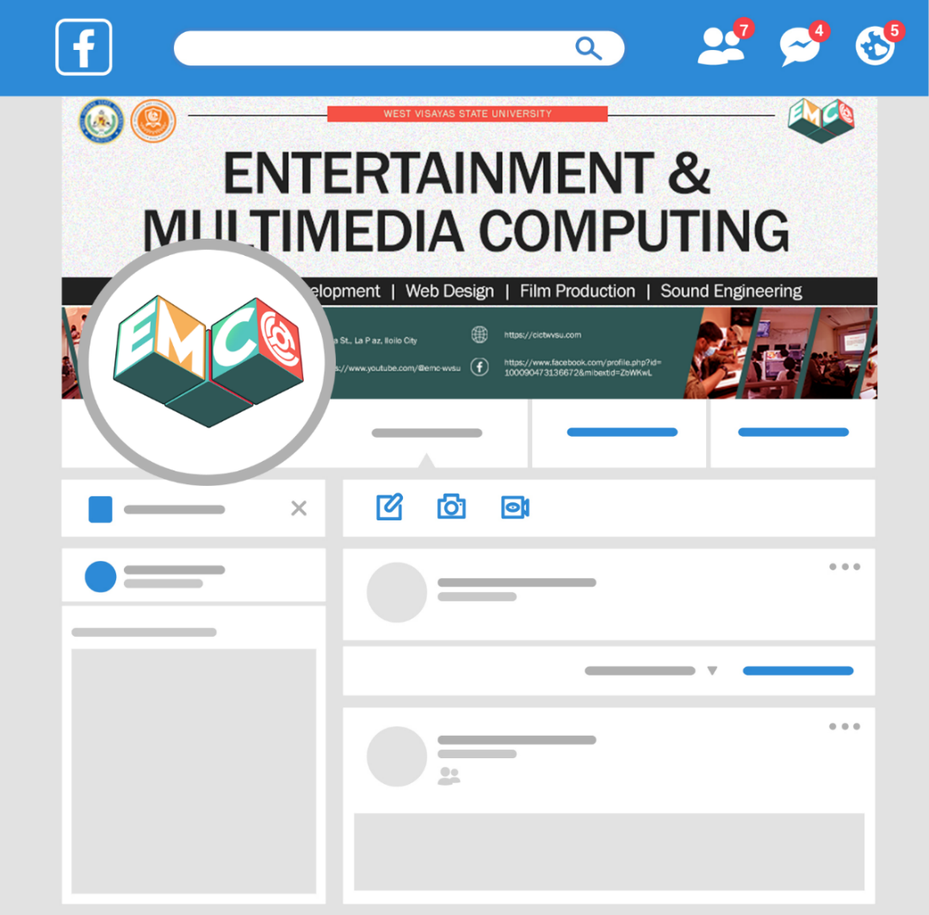

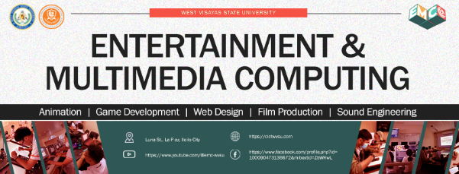
FB Page Profile

Slide 13
Benefits of Youtube
YouTube is a highly engaging platform that allows you to create video content that can educate, inform, and entertain your audience. Video content is also more memorable and shareable than other forms of content.
It is also the second largest search engine in the world, which means that creating a channel can help you rank higher in search results and reach potential students who are actively engaging with online platforms.

Slide 14
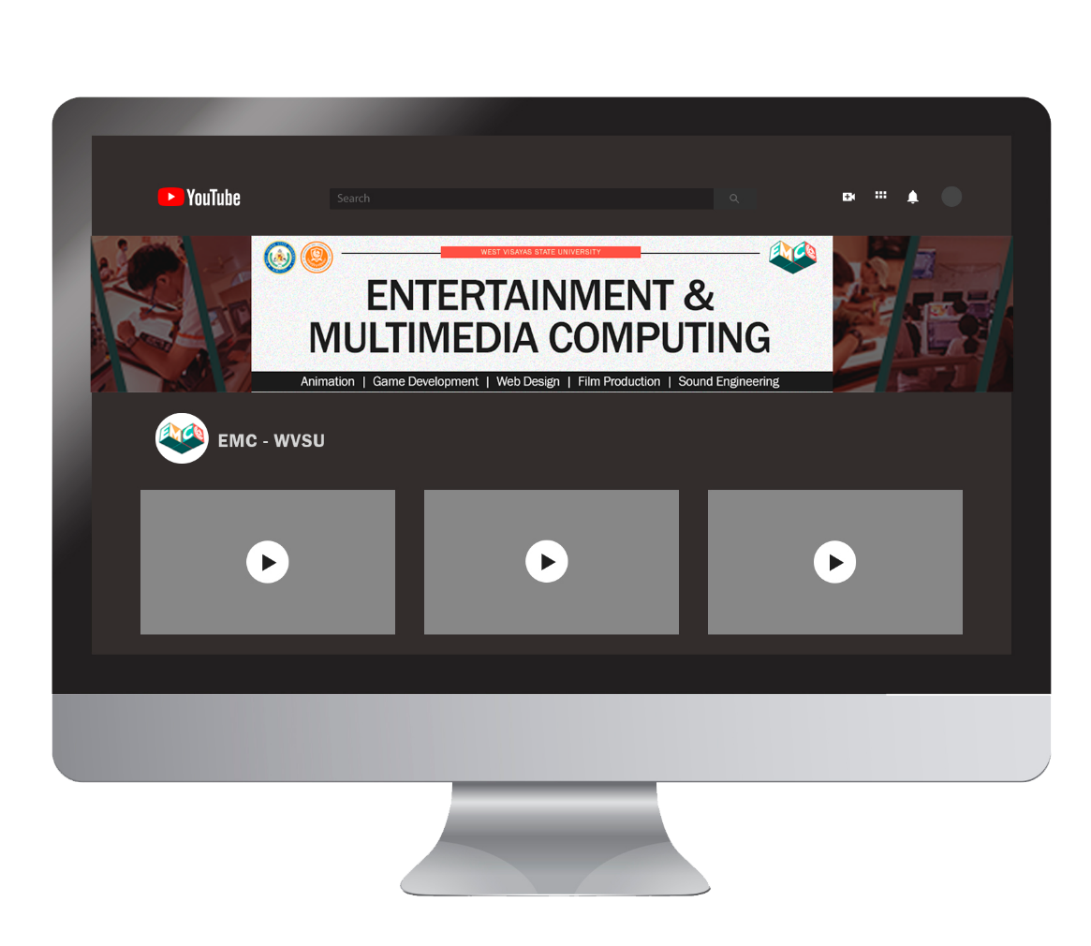

Youtube Channel Profile

Slide 15
Website Content Plan
Course Overview
Programs Offered
Students Portfolio
Events
Organizations

Slide 16
Webpage Design
Course Overview
Programs Offered
Students Portfolio
Events
Organizations

Slide 17
Budget
The cost of launching and maintaining an such platforms is relatively low, and the potential RIO on investment is high.
The marketing team will allocate a budget for targeted advertising and social media management to ensure our the platforms we’ve used is effective and engaging.

Slide 18
FACEBOOK PAGE
Graphic design for the FB page cover | PHP 2,500
Ad campaigns | PHP 15,000
Monthly maintenance and content creation | PHP 25,000
YOUTUBE CHANNEL
Channel art design | PHP 5, 000
Ad campaigns | PHP 20,000
Monthly maintenance and content creation | PHP 30,000
A TOTAL OF
255,000
PESOS
WEBSITE
Domain name registration | PHP 7,500
Webpage design and development | PHP 100,000
Monthly maintenance and content creation for the FB page | PHP 50,000

Slide 19
Timeline

Slide 20
Conclusion
Our marketing strategy plan is designed to successfully launch a promotional video across digital platforms to promote the BS in Entertainment and Multimedia Computing program. Our goal is to make multimedia outputs that is engaging and informative, and that will capture the attention of our target audience.
We will use visuals, videos, and interactive elements to provide our target audience with the information they need to make an informed decision about enrolling in the program, and we will use social media and SEO to ensure that the page, YouTube channel and the website is easily found by potential students.

